Slide 1

Service Center Application
Raja Balwant Singh Engineering Technical Campus,Bichpuri
(Affiliated to Dr. A. P. J. Abdul Kalam Technical University, Lucknow)
Member:-
Avinash Yadav C.S.E 1900040100023
Submitted To:-
Er. Gaurav Singh

Slide 2
Table of content
TOPICS
SLIDE NO.
  Project Abstract ……….4
  Introduction ……….5
  Features ……....6
  Minimum Specifications Required …..…..7
  Flowchart Of The Project ..……..8
  Modules Used .....9,10
  Password Protection ………11
  Home Page ………12
  Add Records …13,14
  Delete Records ………15
  Search Records ………16

Slide 3
Continued…….
Additional Features …17,18
Other Snapshots ………19
Conclusion ………20
References ………21
Thank You ………22

Slide 4
Project Abstract
The main objective of this Service Center software is to develop an information system to store, maintain, update and process data relating to the centre. It will prepare various reports to aid in smooth and speedy functioning of ‘Service Center’ activities. Below are the features of this project/software.
Features:
Manage the records of every customer.
Manage the records of every employee.
Duty allocation of employees.
Maintain accounts.
Prepare bills for different customers.
Generate different kind of necessary reports and queries.
Authorized entry by password access for security reasons.
Provide a simple and easy Graphical User Interface (GUI).

Slide 5
Introduction
The mini project ‘Service Center Application’ is the project for managing service center. The project aims at developing service center application using Python programming language which helps the organization to maintain the proper functioning of the center.
The application uses various python modules and libraries to generate menus, show message boxes and print text on the screen.

Slide 6
Features
Manage the records of every customer.
Manage the records of every employee.
Duty allocation of employees.
Maintain accounts.
Prepare bills for different customers.
Generate different kind of necessary reports and queries.
Authorized entry by password access for security reasons.
Provide a simple and easy Graphical User Interface (GUI).

Slide 7
Minimum specs required
Hardware:
Operation System: Windows 7 or 10, Linux.
CPU: x86 64-bit CPU (Intel/AMD architecture)
RAM: At least 2GB RAM
HARD DISK: 30GB free disk space
Software:
PROCESSOR: QUAD CORE PROCESSOR FOR BETTER PERFORMANCE.
OPERATING SYSTEM: WINDOWS 8, WINDOWS 10, UBUNTU.
MEMORY: 2GB RAM and 30GB MORE HARD DISK SPACE MINIMUM.
LATEST VERSION OF PYTHON AND MYSQL.

Slide 8
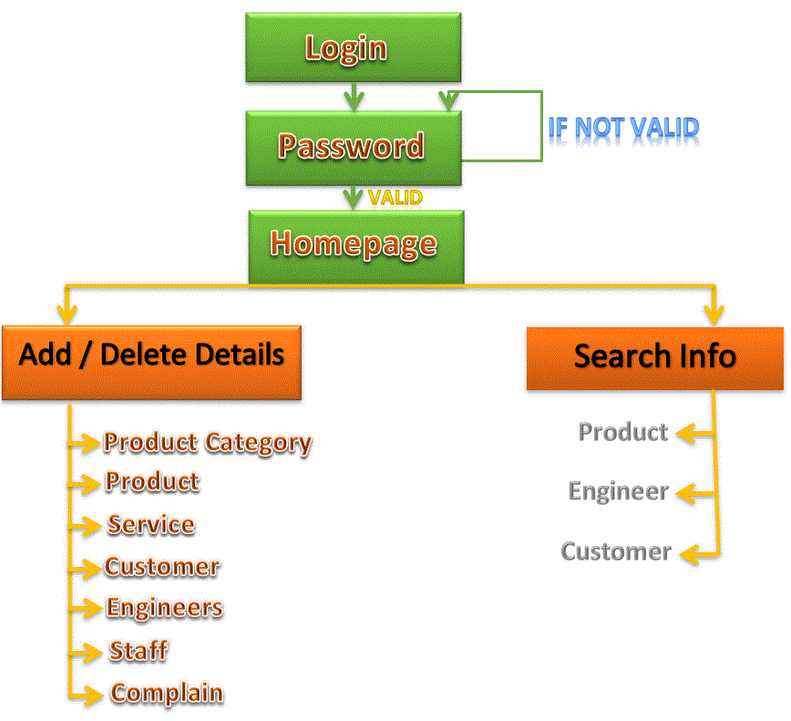
Flow of the project

Slide 9
Modules used
1. TKINTER MODULE:
Python offers multiple options for developing GUI (Graphical User Interface). Out of all the GUI methods, tkinter is the most commonly used method. It is a standard Python interface to the Tk GUI toolkit shipped with Python. Python with tkinter is the fastest and easiest way to create the GUI applications. Creating a GUI using tkinter is an easy task.
2.PYMYSQL:
PyMySQL is an interface for connecting to a MySQL database server from Python. It implements the Python Database API v2.0 and contains a pure-Python MySQL client library. The goal of PyMySQL is to be a drop-in replacement for MySQLdb.

Slide 10
Continued…
3. SMTPLIB
Simple Mail Transfer Protocol (SMTP) is a protocol, which handles sending e-mail and routing e-mail between mail servers.
4. MATPLOTLIB
Matplotlib is an amazing visualization library in Python for 2D plots of arrays. Matplotlib is a multi-platform data visualization library built on NumPy arrays and designed to work with the broader SciPy stack. It was introduced by John Hunter in the year 2002.

Slide 11
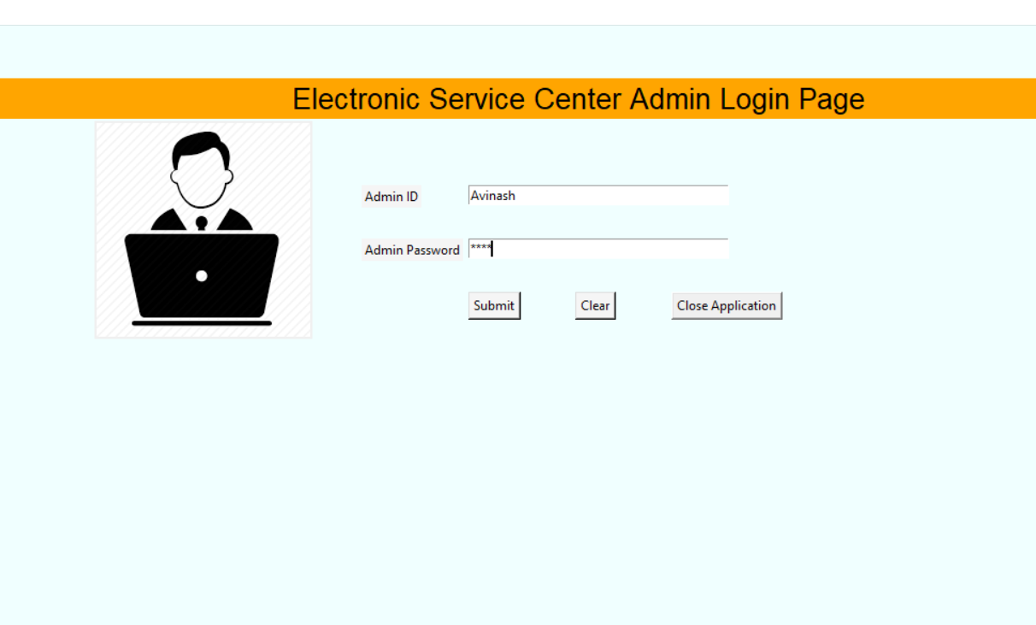
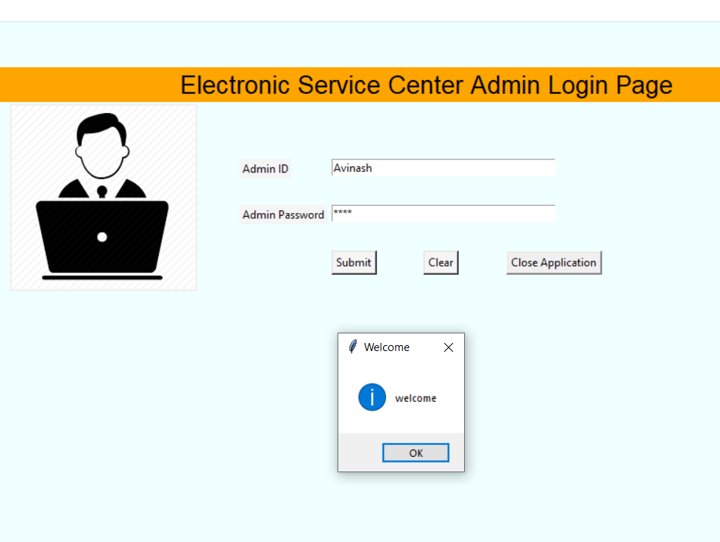
Password protection
The project is password protected i.e. A password is required to use the application. Only the person (administrator) having the password can access the system which makes the system more secure. The admin can change the password from the code of the application.

Slide 12
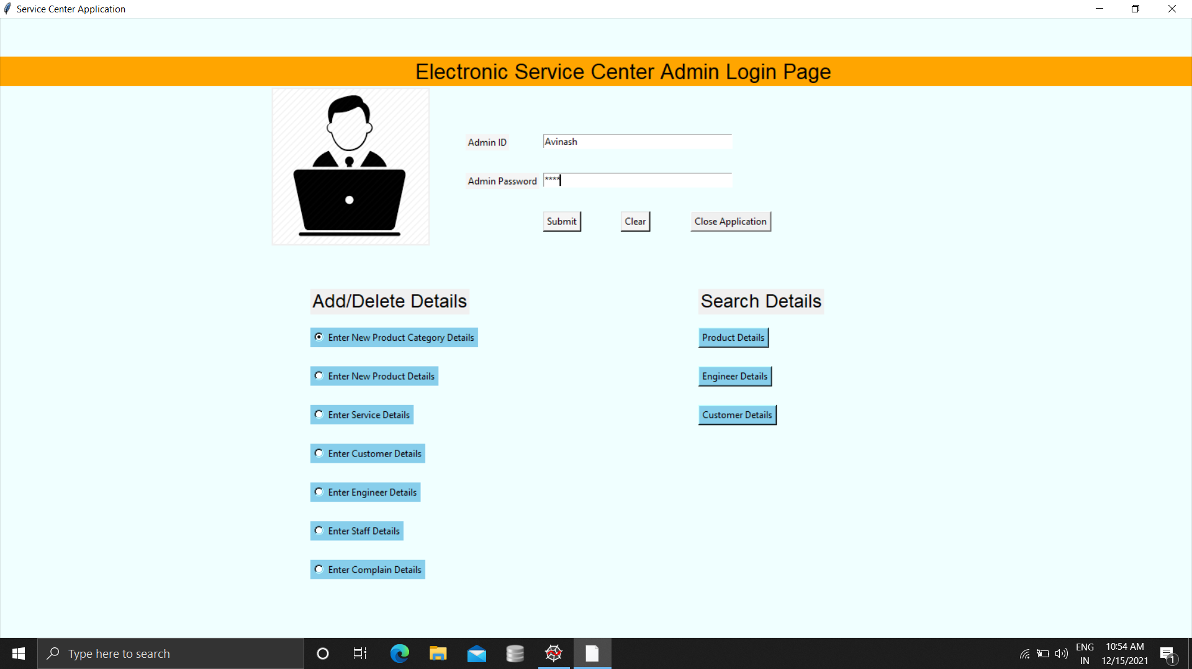
Home page
The home page of the application contain various options through which the user can enjoy various facilities such as adding information of product, customers, staff, engineers, etc.

Slide 13
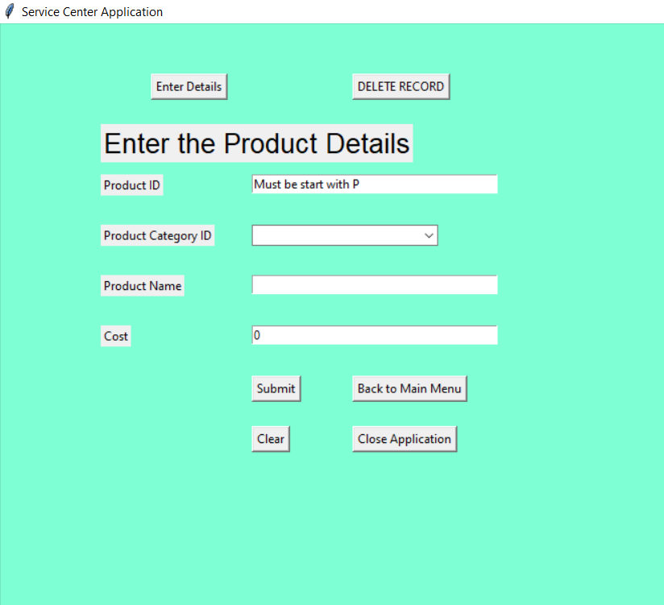
Adding information
The first function of the application is the “Add Records” function which allows the admin to add new records into the database. The Information can be added as per their respective Categories like engineers, product, customer. Data can be added with their respective name, ID, author, etc.

Slide 14
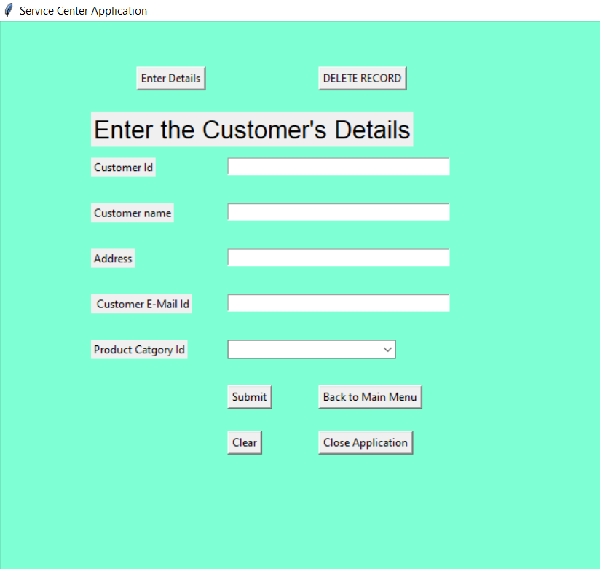
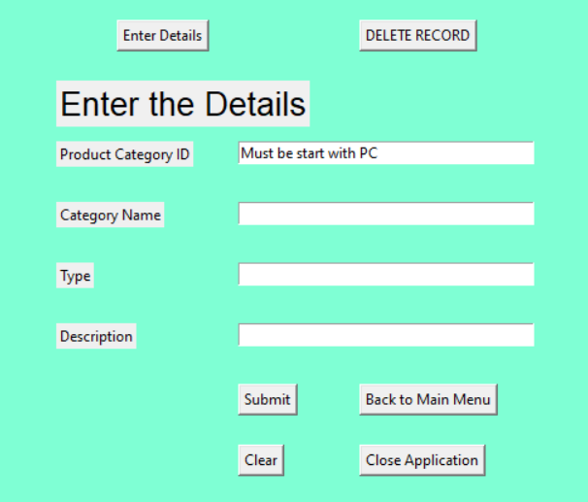
Some other snapshots……
Adding Customer Details
Adding Product Category Details

Slide 15
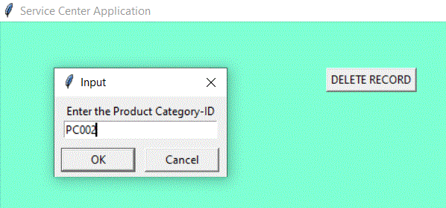
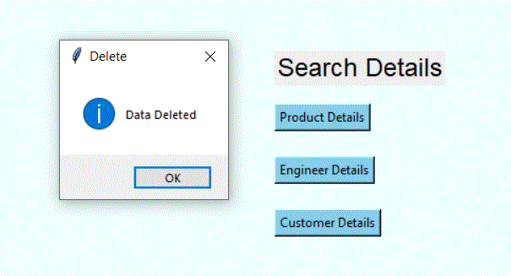
Delete records
The second option in the project is delete record option from where the admin can delete any record from the system. The Item can searched using its respective ID and can be deleted easily by just one click.

Slide 16
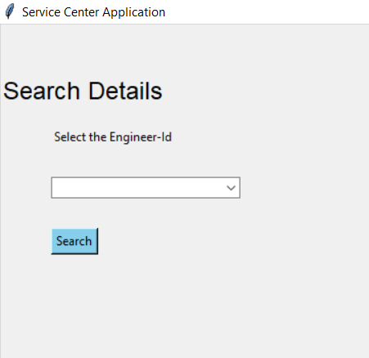
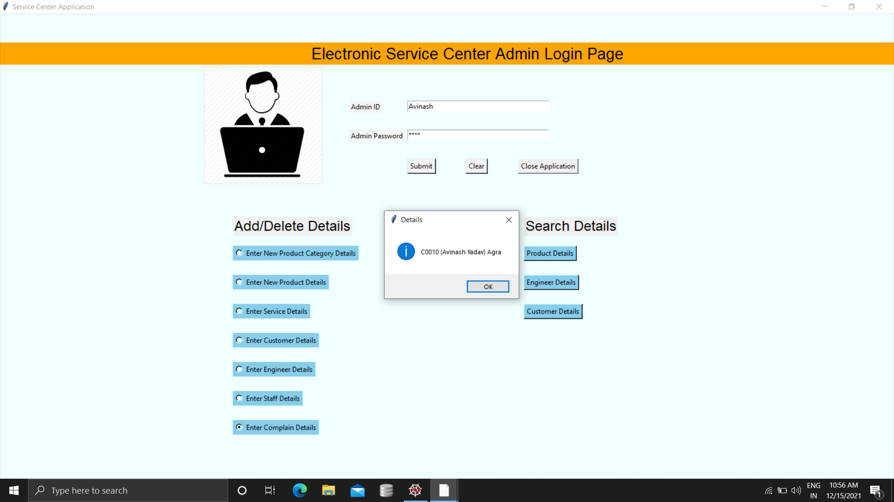
Search record
The admin can easily get the full information of a customer, product, engineer just by using the search book feature. The information can be easily searched with the help of the respective IDs provided at the time of adding the information about them.

Slide 17
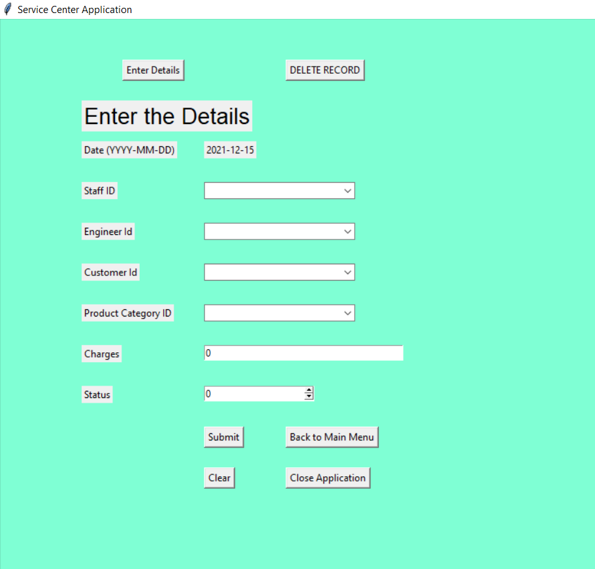
Additional FEATURES
The application has a feature for handling complains about products. It stores the details of product, customer, service given, charges, etc. The application e-mails the details of the complain to the user upon being registered into the system. It also generates a pie-chart of the existing complains in the system which can help in analysis leading to better functioning of the organization.

Slide 18
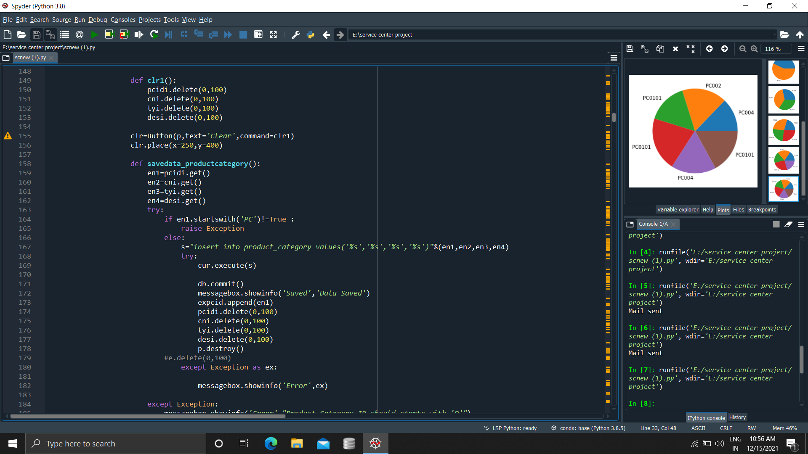
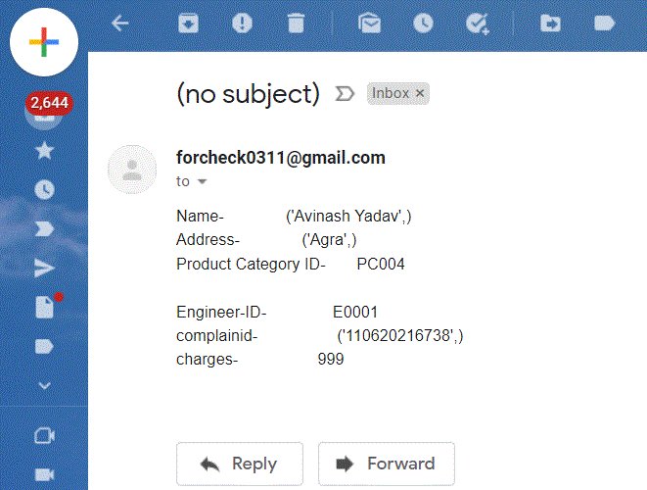
Continued……
Pie Chart of Complains
E-mail to Customer

Slide 19
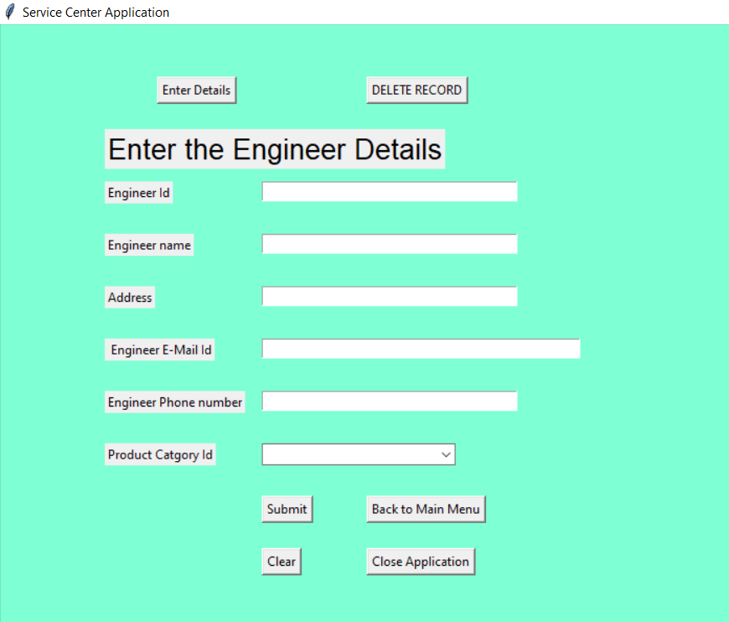
Some other snapshots from the project

Slide 20
Conclusion
This SERVICE CENTER APPLICATION using Python is a reliable and convenient way to reduce paper and cleric work in every organization while increasing the accuracy in organizing the storation of data and reducing the chance of human errors. This project takes care of all the requirements of an organization and is capable to provide easy and effective storage of information related to staff, products, customers, enginers, etc.

Slide 21
References
www.google.com
www.stackoverflow.com
www.GeeksforGeeks.com
SQL and Python Programming by Bryan Johnson

Slide 22
THANK YOU

